Slide 1




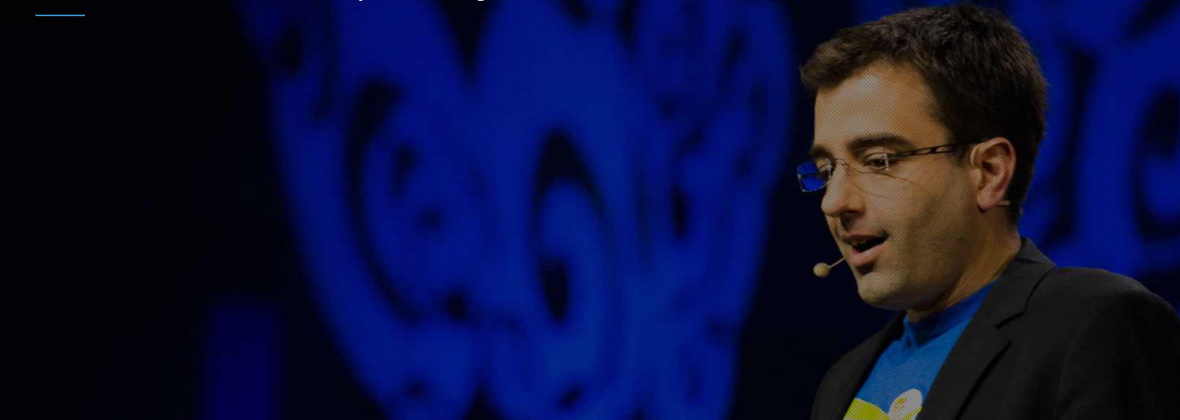

Robust Multi-Domain Descriptive Text Classification Leveraging Conventional and Hybrid Deep Learning Models
Shovan Bhowmik, Sharmin Sultana, Ahmed Arian Sajid, Saha Reno
Bangladesh Army International University of Science and Technology (BAIUST), Bangladesh
International Conference on Computing & Technological
Solutions with Artificial Intelligence [23-25 April 2021]

Slide 2
Introduction
Sequence data classification from semantic analysis is a promising application of NLP.
With easy access to the internet, people are continuously disseminating misleading information through websites and social media which are affecting daily social and political lives.
A multi-domain text classification model has been proposed.
Six conventional DL models along with one hybrid DL model have been utilized with the help of customized word embedding.
Improved accuracy and unvarying performance has been achieved.
Comparison among compilation time of all the models has been demonstrated.
International Conference on Computing & Technological
Solutions with Artificial Intelligence [23-25 April 2021]

Slide 3
Challenges
Lack of Control: Opinion mining is believed to be a complex task given that humans tend to believe misleading information and the lack of control of the spread of false contents.
Limited amount of resources: There are less number of datasets, published literature available which makes it hard to train data.
Vast Knowledge: It can be argued that to manually identify sentiments is to have a vast knowledge of the covered topic. Even with the knowledge, it is considerably hard to successfully identify.
Resource Intensive: The intention, and the impact of creating propaganda by
spreading false contents cannot be measured or understood easily as it has shown to be complex and resource intensive.
International Conference on Computing & Technological
Solutions with Artificial Intelligence [23-25 April 2021]

Slide 4
Theories
Feature Vector Representation
Word Embedding with One Hot Representation
Deep Learning Models
Artificial Neural Network (ANN)
Simple Recurrent Neural Network (Simple RNN)
Gated Recurrent Unit (GRU)
Long Short Term Memory RNN (LSTM)
Bi-Directional LSTM (BLSTM)
Convolutional Neural Network (CNN)
Hybrid LSTM-CNN
International Conference on Computing & Technological
Solutions with Artificial Intelligence [23-25 April 2021]

Slide 5
Ideas
The exponential growth in the number of unstructured text data has necessitated the development of robust mechanisms for text classification.
Since an unprecedented amount of online information is generating daily on a large scale, it has become crucial to do fact-checking and to sieve the genuine data. Otherwise, misinformation will create tumult in society.
Feature Engineering incorporating DL models can help to filter out these kind of unauthenticated news, bully and spam emails.
To find a model which can perform prediction in less time.
International Conference on Computing & Technological
Solutions with Artificial Intelligence [23-25 April 2021]

Slide 6
Literature Review
Author | Work | Limitation
Thota et al. [2018] | - developed a DL model for multi-label fabricated news identification. | - only a single model was proposed and no comparison with other traditional DL models were shown.
Alanazi et al.[2020] | - LSTM and CNN models are applied in filtering spam emails. | - the dataset was biased with a small number of spam emails.
Alam et al [2021] | - proposed an ensemble of conventional ML algorithms for detecting cyberbullying. | - no DL algorithms were applied for comparison.
Our Proposed Model | - proposed a multi-domain text classification technique using six conventional DL models along with one hybrid DL model. | Advantages: Descriptive text classification Comparison between several DL models Improved accuracy and execution time analysis
International Conference on Computing & Technological
Solutions with Artificial Intelligence [23-25 April 2021]

Slide 7
Dataset Statistics
Dataset | Class Label Information |  | Total Data | Longest Sentence Length
Fake News | Fake News | Real News | 18103 | 2347 words
 | 9050 (50%) | 9053 (50%)
Spam Email | Spam | Ham | 15736 | 3336 words
 | 7886 (50.1%) | 7850 (49.9%)
Bully | Offensive | Not offensive | 9093 | 28 words
 | 4929 (54.2%) | 4164 (45.8%)
https://www.kaggle.com/clmentbisaillon/fake-and-real-news-dataset + Politifact + Wikipedia
www.kaggle.com/nitishabharathi/email-spam-dataset
Davidson, T., Warmsley, D., Macy, M., Weber, I.: Automated hate speech detection and the problem of offensive language.
International Conference on Computing & Technological
Solutions with Artificial Intelligence [23-25 April 2021]

Slide 8
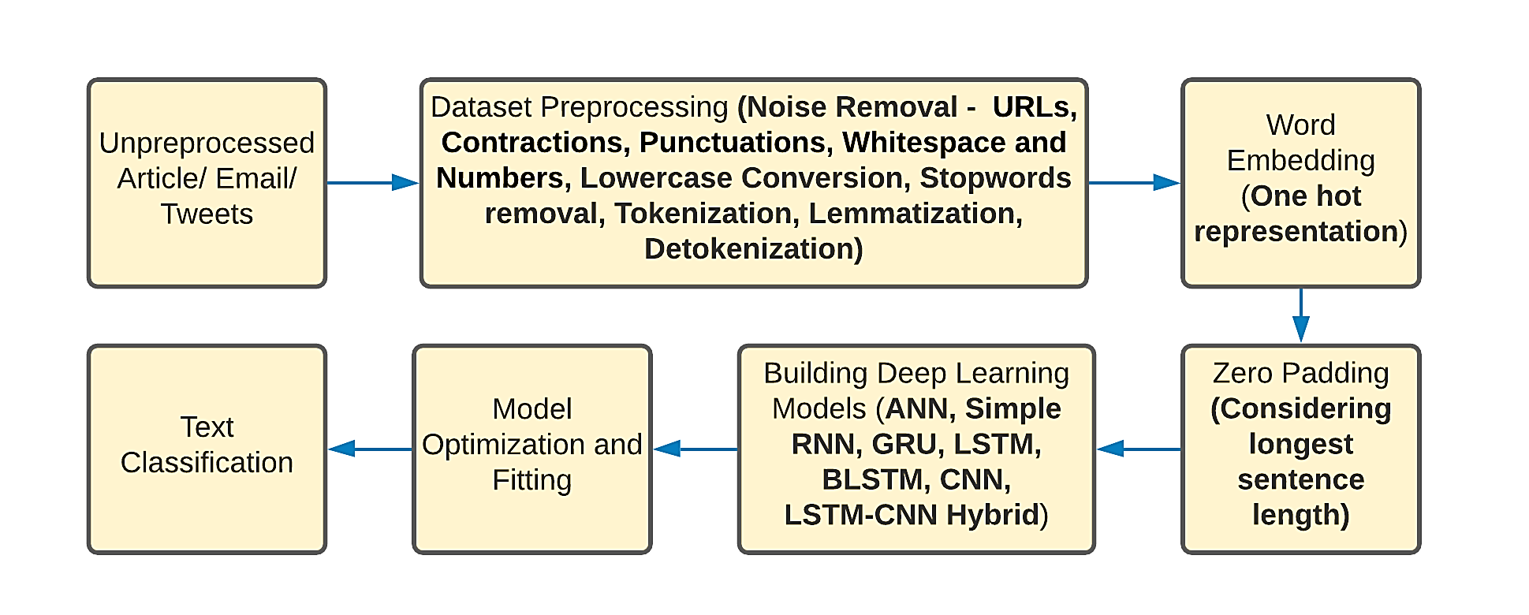
Methods
Fig: Overview of the proposed multi-domain text classification method
International Conference on Computing & Technological
Solutions with Artificial Intelligence [23-25 April 2021]

Slide 9
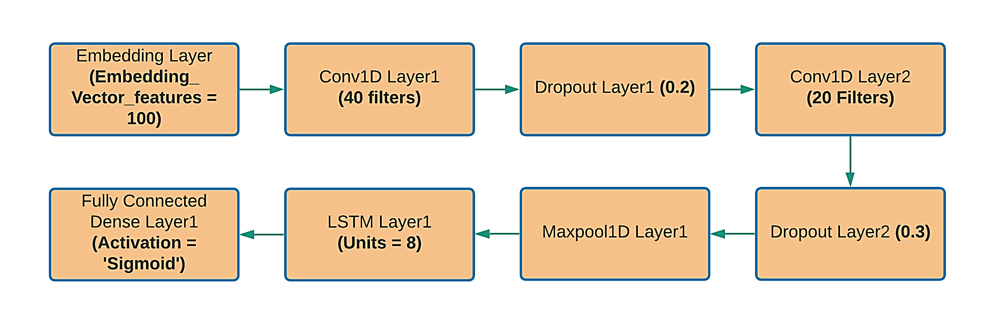
Methods (Cont.)
Fig: Stacking of LSTM-CNN Hybrid Model for Fake News Classification
International Conference on Computing & Technological
Solutions with Artificial Intelligence [23-25 April 2021]

Slide 10
Methods (Cont.)
Dataset Domain | DL Models | Layer Arrangement | Total Params
Fake News | ANN | Dense1(16), Dropout(0.3), Dense2(32), Dropout(0.4), Dense3(8), Flatten() | 5,056,481
 | Simple RNN | SimpleRNN(8) | 5,036,641
 | GRU | GRU(8) | 5,037,449
 | LSTM | LSTM(8) | 5,037,817
 | BLSTM | BLSTM(8) | 5,039,393
 | CNN | Conv1D(40), Conv1D(20), Conv1D(10), GlobalMaxPooling1D() | 5,047,321
 | LSTM – CNN Hybrid | Conv1D(40), Dropout(0.2), Conv1D(20), Dropout(0.3), MaxPool1D(), LSTM(8) | 5,047,637
International Conference on Computing & Technological
Solutions with Artificial Intelligence [23-25 April 2021]

Slide 11
Methods (Cont.)
Dataset Domain | DL Models | Layer Arrangement | Total Params
Spam Email | ANN | Dense1(16), Dropout(0.3), Dense2(32), Dropout(0.4), Dense3(8), Flatten() | 4,705,153
 | Simple RNN | SimpleRNN(8) | 4,677,401
 | GRU | GRU(8) | 4,678,209
 | LSTM | LSTM(8) | 4,678,577
 | BLSTM | BLSTM(8) | 4,680,153
 | CNN | Conv1D(40), Conv1D(20), Conv1D(10), GlobalMaxPooling1D() | 4,688,081
 | LSTM – CNN Hybrid | Conv1D(40), Conv1D(20), Dropout(0.2), MaxPool1D(), Conv1D(10), Conv1D(8), MaxPool1D(), LSTM(8), LSTM(8) | 4,689,415
International Conference on Computing & Technological
Solutions with Artificial Intelligence [23-25 April 2021]

Slide 12
Methods (Cont.)
Dataset Domain | DL Models | Layer Arrangement | Total Params
Bully | ANN | Dense1(16), Dropout(0.3), Dense2(32), Dropout(0.4), Dense3(8), Flatten() | 543,409
 | Simple RNN | SimpleRNN(16) | 542,649
 | GRU | GRU(16) | 544,521
 | LSTM | LSTM(16) | 545,385
 | BLSTM | BLSTM(16) | 549,049
 | CNN | Conv1D(40), Conv1D(20), Conv1D(10), GlobalMaxPooling1D() | 552,801
 | LSTM – CNN Hybrid | Conv1D(40), Conv1D(20), MaxPool1D(), Conv1D(10), Conv1D(8), MaxPool1D(), BLSTM(8), BLSTM(8) | 562,543
International Conference on Computing & Technological
Solutions with Artificial Intelligence [23-25 April 2021]

Slide 13
Methods (Cont.)
Other parameters
Learning Rate: 0.1/0.0001
Batch Size: 512/32
Optimizer: Adam/SGD
Activation Function: Relu/LeakyRelu
Pooling Layer: Maxpool/GlobalMaxPool
Kernel Size: 3/5
Model Splitting: 67/33
International Conference on Computing & Technological
Solutions with Artificial Intelligence [23-25 April 2021]

Slide 14
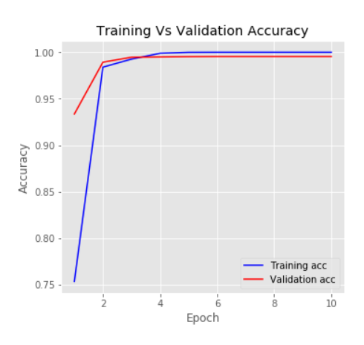
Result
Dataset Domain | DL Models | Accuracy (%) | F1 Score (%) | AUC Area (%) | Time per Epoch (Seconds) | Wrong Prediction (%)
Fake News | ANN | 99.13 | 99.00 | 99.63 | 55.21 | 0.87
 | Simple RNN | 96.92 | 97.00 | 96.92 | 150.28 | 3.08
 | GRU | 99.41 | 99.00 | 99.41 | 634.10 | 0.59
 | LSTM | 99.20 | 99.00 | 98.54 | 156.90 | 0.80
 | BLSTM | 98.86 | 98.00 | 98.87 | 155.66 | 1.14
 | CNN | 99.55 | 99.00 | 99.55 | 77.10 | 0.45
 | LSTM – CNN Hybrid | 98.88 | 99.00 | 98.88 | 89.59 | 1.12
Fig: Training vs Validation accuracy curve for CNN model on Fake News classifier Domain
International Conference on Computing & Technological
Solutions with Artificial Intelligence [23-25 April 2021]

Slide 15
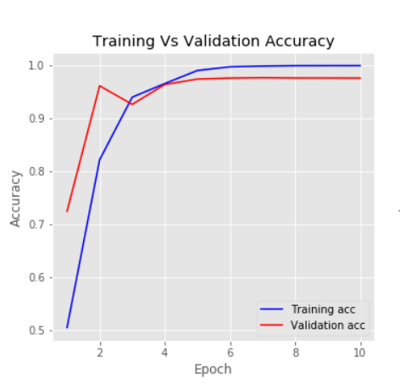
Result (Cont.)
Dataset Domain | DL Models | Accuracy (%) | F1 Score (%) | AUC Area (%) | Time per Epoch (Seconds) | Wrong Prediction (%)
Spam Email | ANN | 97.42 | 97.00 | 97.40 | 71.14 | 2.58
 | Simple RNN | 94.84 | 95.00 | 94.87 | 107.65 | 5.16
 | GRU | 95.92 | 96.00 | 95.89 | 282.58 | 4.08
 | LSTM | 96.88 | 97.00 | 96.83 | 213.76 | 3.12
 | BLSTM | 97.25 | 97.00 | 97.25 | 798.30 | 2.75
 | CNN | 97.42 | 97.00 | 97.41 | 145.95 | 2.58
 | LSTM – CNN Hybrid | 97.57 | 98.00 | 97.58 | 192.77 | 2.43
Fig: Training vs Validation accuracy curve for LSTM-CNN model on Spam Email classifier Domain
International Conference on Computing & Technological
Solutions with Artificial Intelligence [23-25 April 2021]

Slide 16
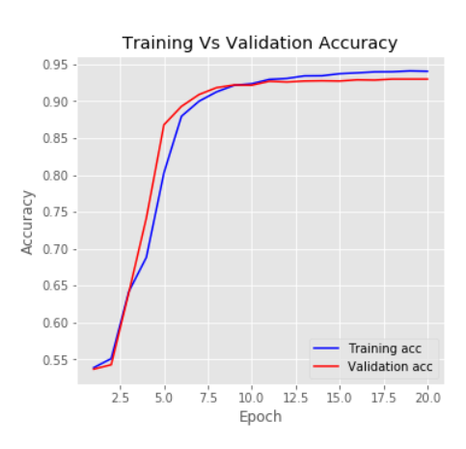
Result (Cont.)
Dataset Domain | DL Models | Accuracy (%) | F1 Score (%) | AUC Area (%) | Time per Epoch (Seconds) | Wrong Prediction (%)
Bully | ANN | 90.77 | 90.50 | 90.88 | 5.16 | 9.23
 | Simple RNN | 92.20 | 92.00 | 92.11 | 9.97 | 7.80
 | GRU | 92.80 | 92.50 | 92.93 | 11.55 | 7.20
 | LSTM | 91.90 | 92.00 | 92.19 | 11.72 | 8.10
 | BLSTM | 92.80 | 92.50 | 92.82 | 10.84 | 7.20
 | CNN | 93.00 | 93.00 | 93.12 | 5.73 | 7.00
 | LSTM – CNN Hybrid | 92.80 | 92.50 | 92.79 | 11.34 | 7.20
Fig: Training vs Validation accuracy curve for CNN model on Bully classifier Domain
International Conference on Computing & Technological
Solutions with Artificial Intelligence [23-25 April 2021]

Slide 17
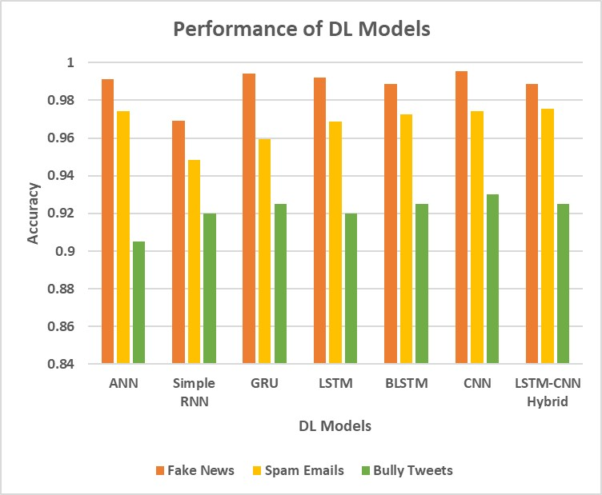
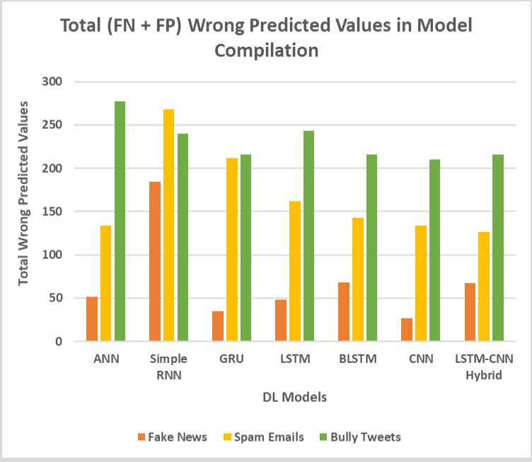
Result (Cont.)
Fig: Accuracy of all the DL models in three text domains
Fig: Compilation time per epoch for all the DL models in three text domains
International Conference on Computing & Technological
Solutions with Artificial Intelligence [23-25 April 2021]

Slide 18
Conclusion
We have focused our center of attention on descriptive documents to differentiate them into two classes using deep learning and feature engineering.
Our empirical results show the rigid performance of all models on a corpus with maximum accuracy of 99.55%, 97.57% and 93.00% for fake news, spam email and cyberbullying domains.
Our models can be easily deployed to websites for the prediction of misleading news or spam emails as well as in harassment and fraudulent activity identification.
In the future, more advanced techniques related to NLP like transformers, attention models can be applied for further analysis.
International Conference on Computing & Technological
Solutions with Artificial Intelligence [23-25 April 2021]

Slide 19
Thank You
International Conference on Computing & Technological
Solutions with Artificial Intelligence [23-25 April 2021]

Slide 20
Any Question?
International Conference on Computing & Technological
Solutions with Artificial Intelligence [23-25 April 2021]

